Slide 1
SharePoint Framework Extensions: List View Command Set
List View Command Sets

Slide 2

Command Sets
Overview
Debugging & Testing
Deploying

Slide 3
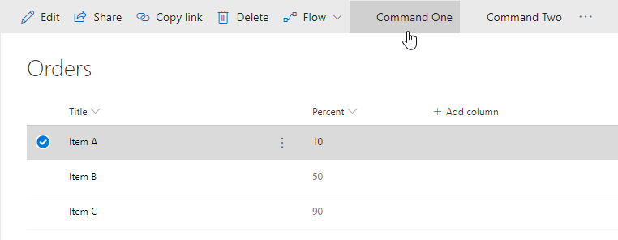
List View Command Sets
Add buttons to modern lists & libraries
Add to toolbar
Add to item context menus
Or both!
Control visibility state of button based on state of view
Similar to pre-SPFx / classic mode customizations
Custom actions
Example scenarios
Start external process
Execute custom script when clicked

Slide 4
Defining Command Set Buttons
// *.manifest.json
{
"items": {
"ONE_ITEM_SELECTED": {
"title": { "default": "One Item Selected" },
"iconImageUrl": "icons/request.png",
"type": "command"
},
"ALWAYS_ON": {
"title": { "default": "Always On" },
"iconImageUrl": "icons/cancel.png",
"type": "command"
}
}
}

Slide 5
Command Set Class
export interface ICommandSetDemoCommandSetProperties {
messagePrefix: string;
}
export default class CommandSetDemoCommandSet
extends BaseListViewCommandSet<ICommandSetDemoCommandSetProperties> {
@override
public onInit(): Promise<void> {
}
@override
public onListViewUpdated(event: IListViewCommandSetListViewUpdatedParameters): void {
// fired when state of list view changes
}
@override
public onExecute(event: IListViewCommandSetExecuteEventParameters): void {
// what happens when button is selected
}
}

Slide 6
Debugging & Testing Command Sets
Unlike web parts, extensions require a live SharePoint list and/or library
Can still build and host extension project locally while testing in a remote SharePoint site
Similar experience to using hosted SharePoint workbench for web part development, testing & debugging
Configurations added to each project by the SPFx Yeoman generator simplifying loading SharePoint sites

Slide 7
Deployment
Extension deployment utilizes existing Feature framework
Command set: <CustomAction>
Deployment similar to web parts
Upload SharePoint Package to tenant / site collection app catalog
Install app
Some extensions type support tenant-wide deployment

Slide 8
Tenant Wide Deployment
Automatically deploy extension to all sites in a SharePoint Online tenant
Bypasses need for installation in each site collection
Make available for specific web or list templates
Specify public properties on extension across all sites
Default experience by presence of ClientSideInstances.xml in *.sppkg
Delete this file if tenant wide deployment not desired

Slide 9
List: Tenant Wide Extensions
Control tenant wide deployments with this app catalog list
Column | Type | Description
Title | string | Title of the entry. Can be descriptive entry for the registration. Doesn’t have to match anything, just for your reference
Component ID | GUID | Manifest ID of the component. Has to be in GUID format and component must exists in the app catalog.
Component Properties | string | Optional component properties.
Web Template | string | Can be used to target extension only to specific web template.
List Template | int | List type as a number.
Location | string | Location of the entry. There are different support locations for application customizers and List View Command Sets.
Sequence | int | Sequence of the entry in rendering.
Disabled | Boolean | Enabled state of the deployment.

Slide 10
Demo Creating SharePoint Framework List View Command Sets

Slide 11

Summary
Overview
Debugging & Testing
Deploying

Slide 12
Reading further
Overview of the SharePoint Framework
https://docs.microsoft.com/sharepoint/dev/spfx/sharepoint-framework-overview
Overview of SharePoint Framework Extensions
https://docs.microsoft.com/sharepoint/dev/spfx/extensions/overview-extensions
Build your First ListView Command Set extension
https://docs.microsoft.com/en-us/sharepoint/dev/spfx/extensions/get-started/building-simple-cmdset-with-dialog-api

Slide 13
Thank you.

